Slide 1
WELCOME TO OUR CLASS

Slide 2
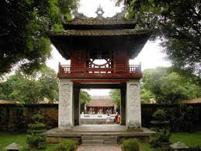
UNIT 6: THE FIRST UNIVERSITY IN VIET NAM
PERIOD….. LESSON 2: ACLOSER LOOK 1
1. Where is it ?
2. What is it now ?
3. When was it founded ?
4. What is it famous for ?

Slide 3
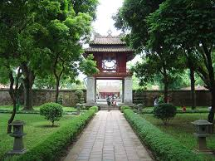
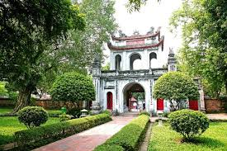
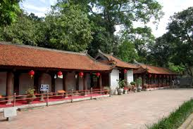
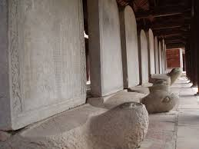
a
d
b
e
c

Slide 4
1. The Temples of Literature

Slide 5
2.Thien Quang Tinh well

Slide 6
3. Doctors’ stone tablet

Slide 7
4. Van Mieu Gate

Slide 8
5. Khue Van Pavilion

Slide 9
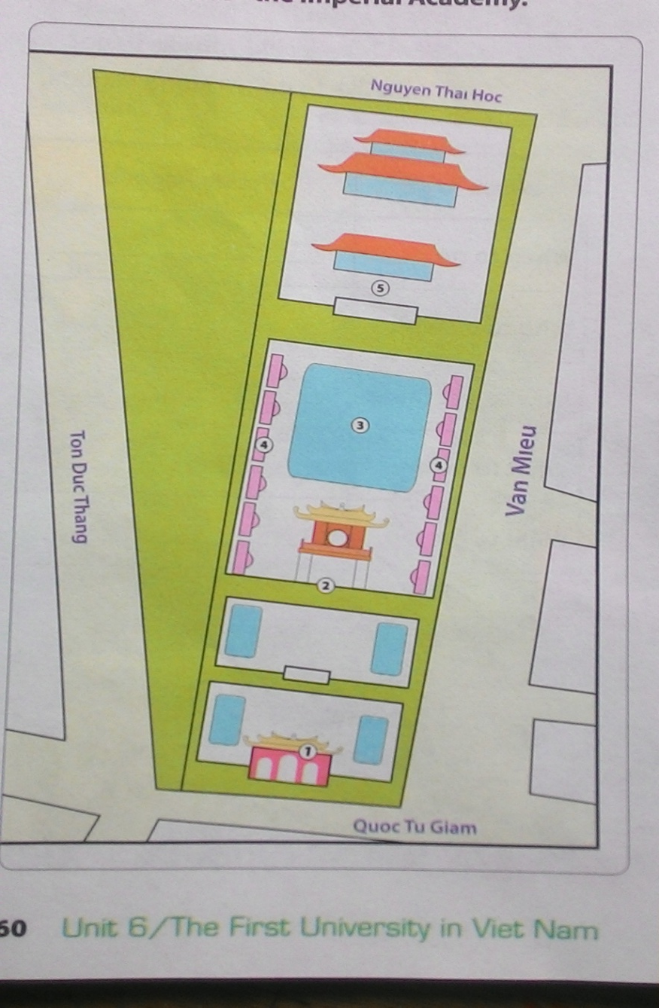
2. Read the names in 1 again and listen to the recording. Complete the layout of the Temple of Literature.
1
Van Mieu Gate
2
Khue Van Pavilion
3
Thien Quang Tịnh well
4
Doctors’ stone tablet
5
Doctors’ stone tablet

Slide 10
3. With a partner, use the prepositions in the box below to describe the layout of the Temple of Literature.
in
at the back of
in front of
behind
In the middle of
between
Next to
The temple of literature is very big. The entrance is called Van Mieu Gate. Khue Van pavilion is behind the Van Mieu. Thien Quang Tinh well is between Doctor’s stone tablets. Van Mieu is at the back of Thien Quang Tinh well.
behind
between
at the back of

Slide 11
2. PRONUNCIATION
/ tʃ / and / dʒ
4. Listen and write the words in the correct columns. Pay attention to the sounds / tʃ / and / dʒ /.
teach | question | chair | village
culture | heritage | jeans | architectural
engineer | children | job | watch
/ tʃ/
Children, chair, architectural, question, culture, watch, teach.
/ dʒ /
job, jean, engineer, heritage, village

Slide 12
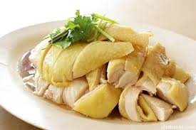
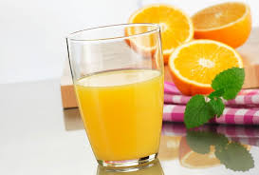
5. Listen and repeat the chant
ORANGE
Orange juice, orange juice,
Cherry jam, cherry jam,
Which one is cheaper for children?
Orange juice is cheap.
Cherry jam is cheaper
CHICKEN
Chicken chop, chicken chop,
Chip chop, chip chop,
Who like chicken chop for lunch?
John likes chicken chop.
Jill likes pork chop.
/ tʃ/
: chicken, chop, cherry, chip, cheap, cheaper, which, lunch.
/ dʒ /
: orange, jam, juice, Jill, John

Slide 13
HOME WORK
+ Learn by heart the words about food and drinks
+ practice two sounds more
+ Prepare for :A closer look 2.

